Slide 1
Introduction to Digital Humanities
Project Presentation
Fengdi Huang & Zhen Pan

Slide 2
Contents of this Presentation
Analyzing Public Opinion and Political Spectrums in China on Zhihu.com
Project Objectives | What this project aims to find
Project Methodology | Web scraping, sentiment analysis, Topic Modeling through LDA, PCA, aspect-based analysis
Topic Modeling | How to conduct Topic Modeling and what did we use
PCA…LDA…EFA…ABA…What are they? | A brief introduction of all the methods we used and didn’t use……
Examples | Using examples to demostrate the results
What’s next | So far, this project is not done yet and still has a lot of potential
Special Thanks to:
ChatGPT 3.5 for Helping with Code
You can visit our projects: https://github.com/JesseLovesGrace/CN_Spectrum

Slide 3
Table of contents
01
02
03
04
05
06
Project Objectives
Project Methodologies
Topic Modeling
Details about Approaches
Examples
What’s next

Slide 4
01
Introduction

Slide 5

What is our Project?
What is our project about?
What are the methods we are going to use?
What are the major components of this research?
And what do we hope to find?

Slide 6
What is our Project?
In a nutshell:
•To Understand Public Opinions in China
•To find the Gap between Public Sentiment and Government Narratives
•And to further analyze the mechanism of this gap
All with the help of different NLP tools and Statistics.

Slide 7
Why this is important/interesting?

Slide 8


Slide 9
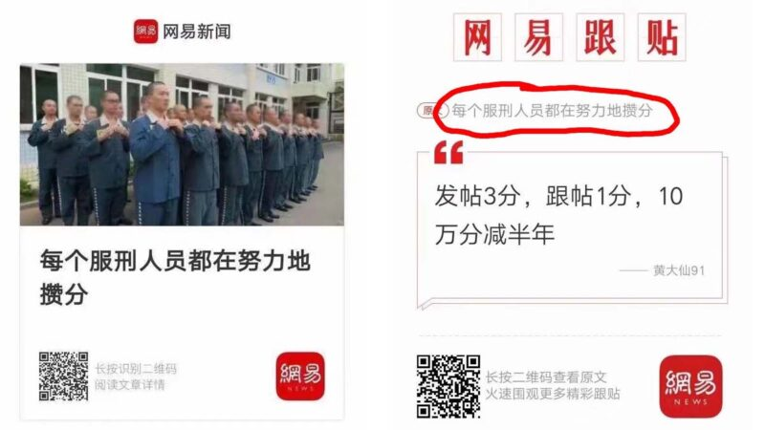
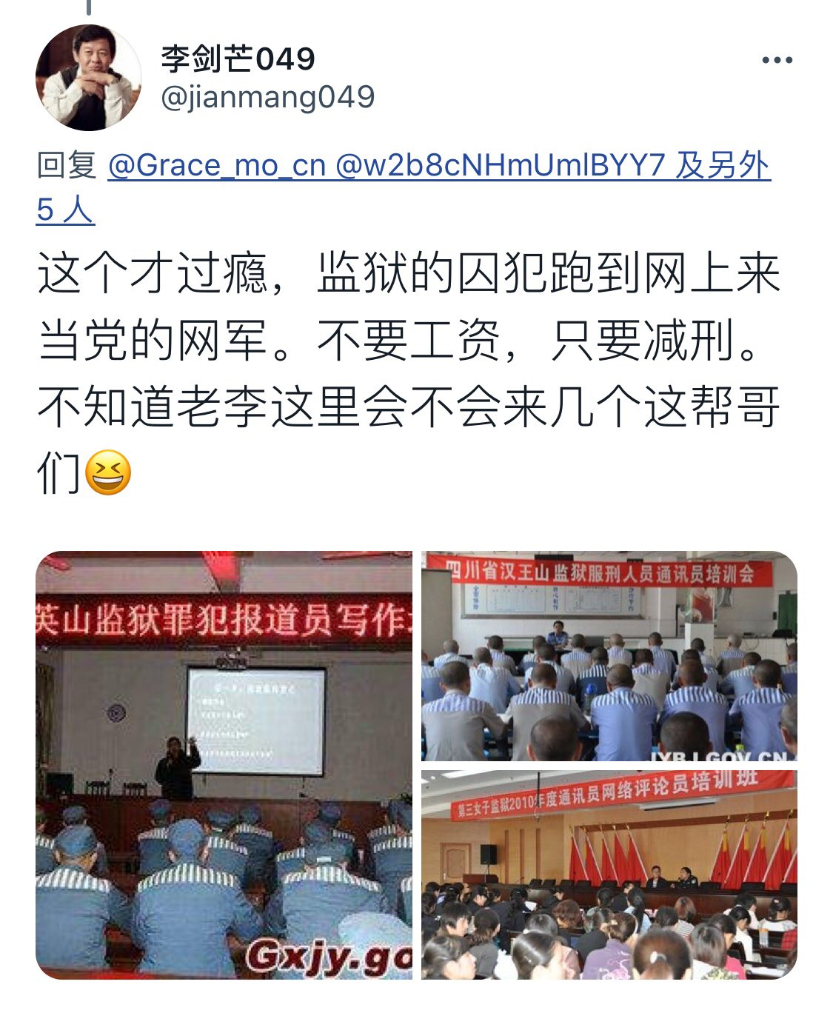
For those who don’t speak Chinese:
this basically says the prisoners can reduce their sentence by posting Pro-China comments on Twitter, YouTube and other social medias.

Slide 10
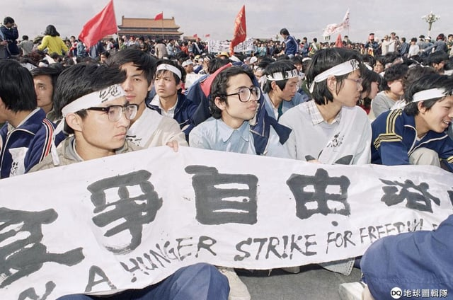
Complains?
Okay…
Collective Action?
Hell No!

Slide 11
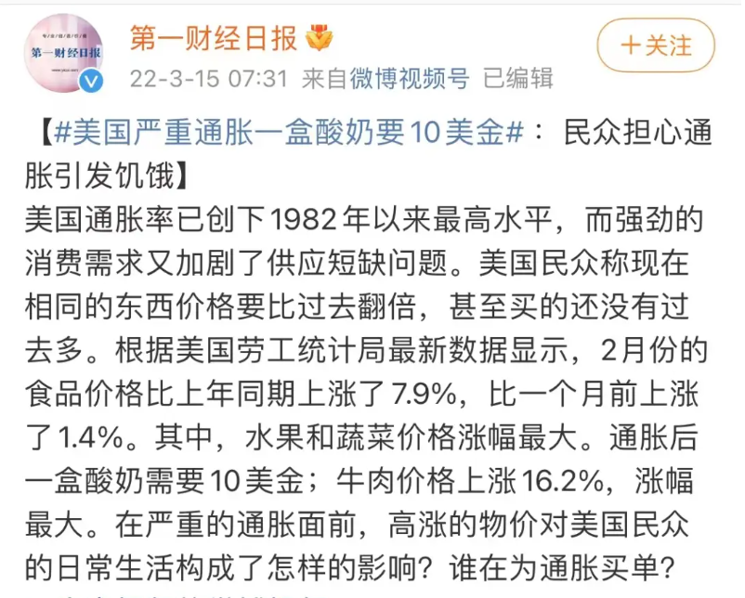

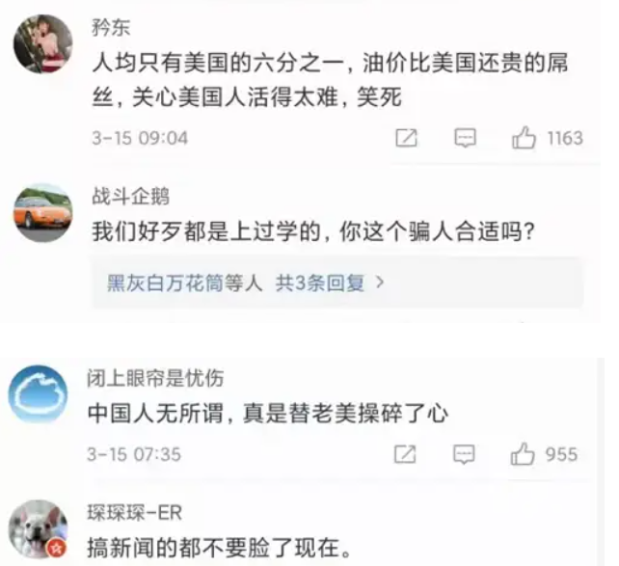
For Example: Here is a post from China Business Network saying that the consumer product price has been rising in the United States by 7.9% and average citizens couldn’t afford yogurt.
Comment sections are all critics, like:
“Well, it’s my bad that I know English”,
“Cancel English at school if you want to fool us.”.
“You should be called American Business Network because the gas price is higher here than the US yet our income is only 1/6 of that in the US. But you will never report that!”

Slide 12
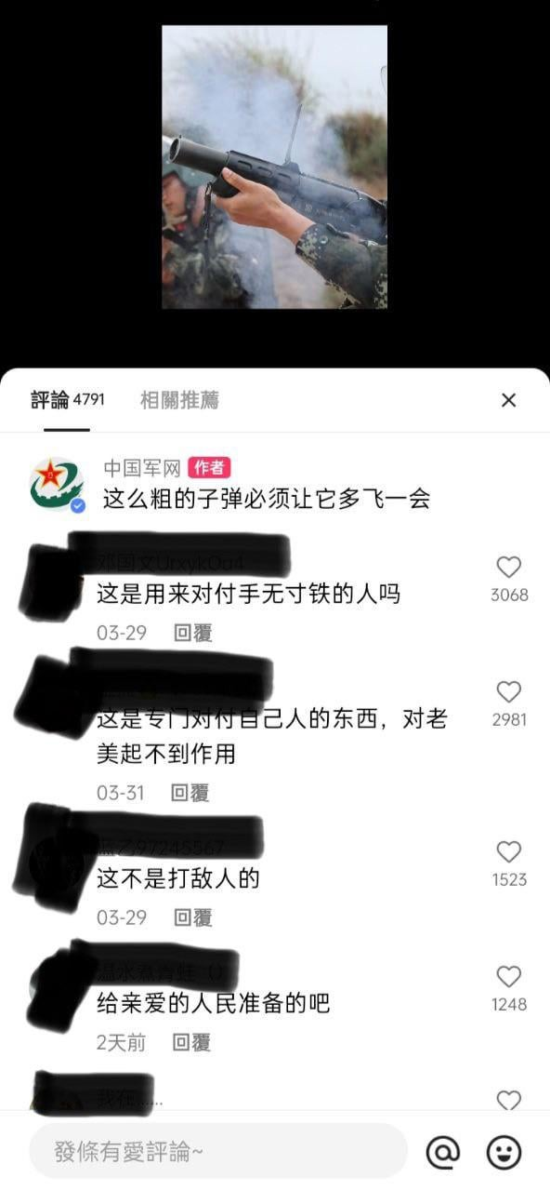
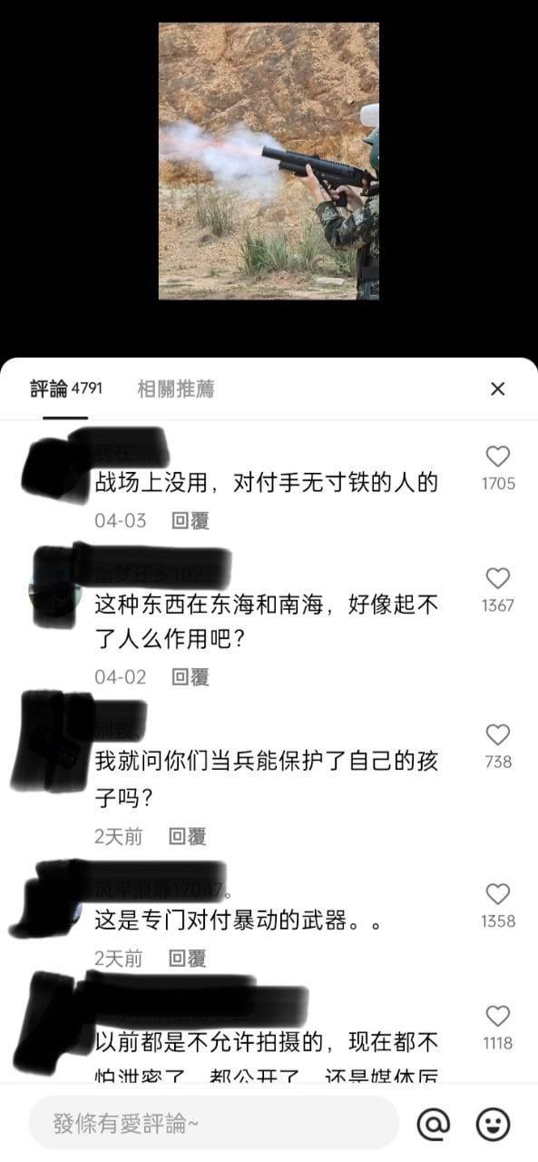
Under a news where PLA shows its new weapon.
Comment Section:
“Are these for Americans? No! For us? Yes!”
“I guess I’ll have a taste of that gas before Americans”
“A “tear dropping” gift to its beloved people!”
“You guys always complain that the tax money are not spent on tax payers, now here is an example how tax money will be spent on tax payers.”

Slide 13
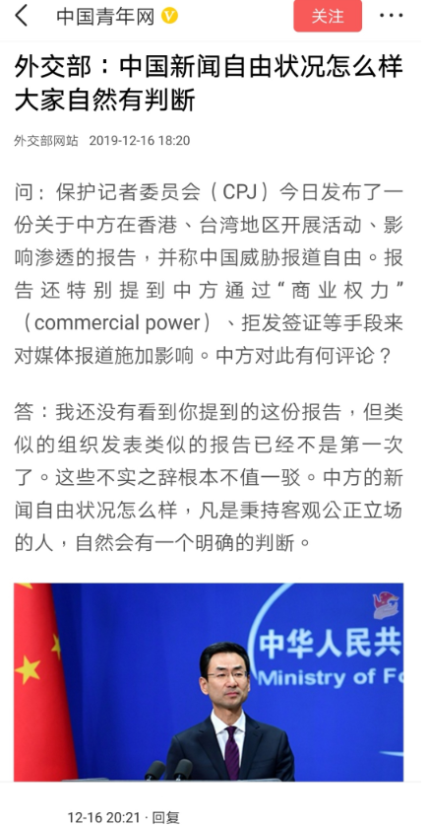
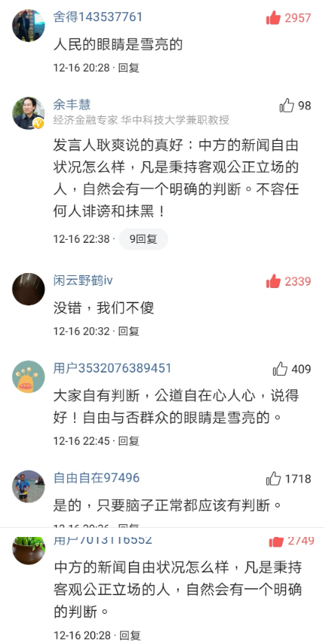
Under a news where the Ministry of Foreign Affairs stating that “it is obvious whether there is freedom of speech in China.”
Comment Section:
“Yes, it is very obvious whether there is freedom of speech in China, but we are not allowed to say the answer.”
“It doesn’t take a genius to know the answer to this question. But it would take a moron to say it out loud”

Slide 14
Like I said:
Complains?
Okay…
Call for Collective Action?
You Get Censored!

Slide 15
What is our Project?
Basic Goal
Further Analysis
• Further analyze the mechanism of this gap:
Is the government incapable of understanding public needs?
Or is the gap between public opinion and government narrative an intentional disregard of public sentiment?
If intentional, does this behavior reflect the government's priorities or highlight potential concerns?
• To Understand Public Opinions in China
• To find the Gap between Public Sentiment and Government Narratives (from public statements, internal references and news from state owned press)

Slide 16
Major Components of this Research
Data Collection through Web Crawler
Quantitative Analysis with Existing Tools
Qualitative Analysis by Manually Reading Posts
The data collected includes:
the author’s profile name, profile description, homepage, gender, timestamp, number of followers, comments, likes and thumbs-ups,
and of course, the posted content.
Methods include:
Sentiment Analysis
LDA Clustering based on TF-IDF and DTM,
PCA Visualization
Aspect-Based Analysis
And some more
We need to manually read as many posts as possible under different clusters to really understand what is happening within these clusters.
And also, we wish to find something interesting.

Slide 17
Are you satisfied with the results?

Slide 18


Slide 19
02
Methodologies

Slide 20
What is the most challenging part of this research?

Slide 21

Building Web Scraping Tools without Breaking the Law
In China, information control are strict, and sometimes, scraping a website for what the authority considers “sensitive information” may pose legal risks.
Collecting information without logging in is most tricky part.

Slide 22
Building Web Scraping Tools without Breaking the Law
We managed to achieve scraping Zhihu.com (Chinese Quora) without logging in.
I hope I don’t get a call from Chinese Police.

Slide 23
356,179 rows…
…of data on 15 different topics so far……
topics including birth rate, abolishing death sentence, religion, American hegemony, Chinese traditional culture, gender issues, marriage, patriotism vs nationalism, governmental corruption, social injustice, 996, freedom of speech and etc.…

Slide 24
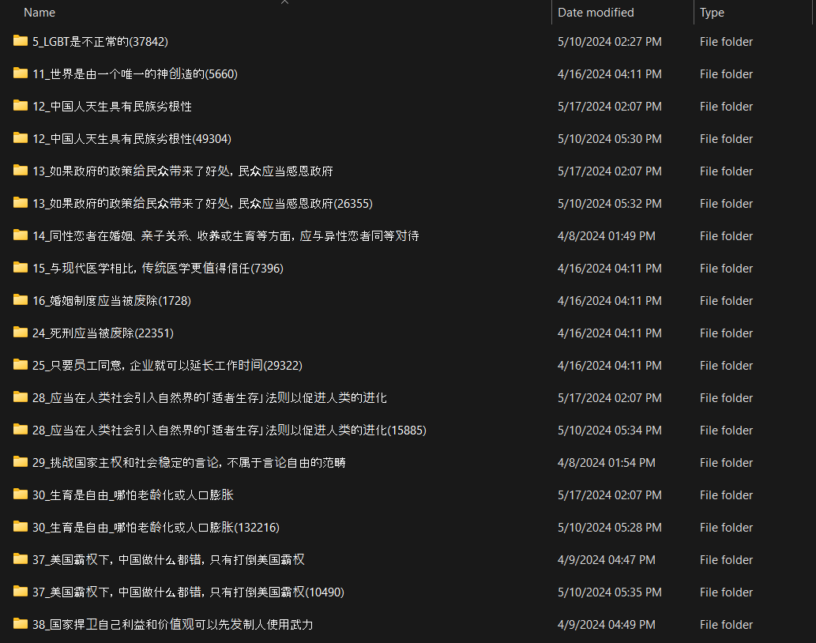

Slide 25
0. What are the tools and methods used in this research?

Slide 26
What are the methods used in this research and how do they work?
Sentiment Analysis
LDA Topic Modeling (based on Document Term Matrix and TF-IDF Score)
Principal Component Analysis (PCA)
Aspect-Based Analysis

Slide 27
1. What is Sentiment Analysis?

Slide 28
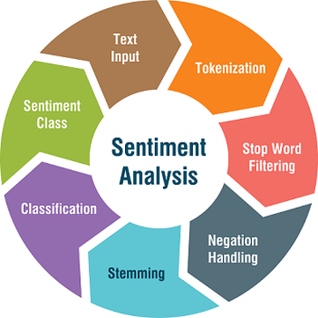
Sentiment Analysis
Sentiment analysis: a technique used to determine whether a piece of text expresses a positive, negative, or neutral emotion with the help of a variety of machine learning models.
Think of it as a way for computers to “understand” human emotions from written language.

Slide 29
Sentiment Analysis
Most common models:
Naïve Bayes Classifier
Logistic Regression
Support Vector Machines
Decision Tress and Random Forests
Neural Networks and Deep learning Models (RNNs or CNNs)

Slide 30
How does it help with our Research?
Have a big picture of the public sentiment on different topics
Can identify the posts with strong sentiments and perhaps manually analyze it

Slide 31
2.1. What is LDA Topic Modeling?

Slide 32
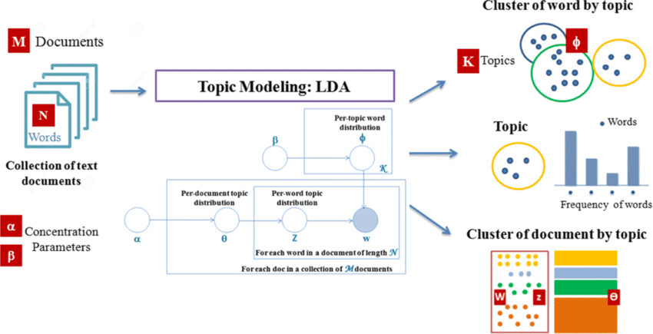

Slide 33
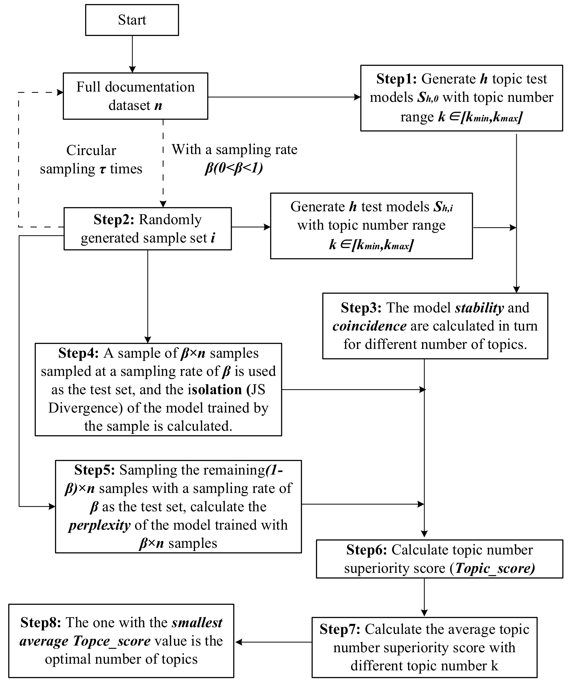
LDA Topic Modeling
LDA, which stands for Latent Dirichlet Allocation, is a technique used in natural language processing to find topics in a collection of documents.
It is calculated based on TF-IDF Score
Think of it as a way to automatically discover the topics that different documents talk about, without needing to read them all.

Slide 34
LDA Topic Modeling
Imagine you have these three documents:
"The game was exciting and the team played well.“
"The fashion show featured beautiful designs and stylish clothes.“
"The technology conference showcased innovative gadgets and new software."

Slide 35
LDA Topic Modeling
LDA might figure out that there are three topics:
Sports: key words like "game," "team," "played."
Fashion: key words like "fashion," "designs," "clothes."
Technology: key words like "technology," "gadgets," "software."

Slide 36
LDA Topic Modeling
And based on the key words, it will determine that:
Document 1 is mostly about sports.
Document 2 is mostly about fashion.
Document 3 is mostly about technology.

Slide 37
LDA Topic Modeling
And based on the key words, it will determine that:
Document 1 is mostly about sports.
Document 2 is mostly about fashion.
Document 3 is mostly about technology.
Now, try to replace the Keywords with Top Terms with highest TF-IDF Scores

Slide 38
2.2. What is TF-IDF Score?

Slide 39
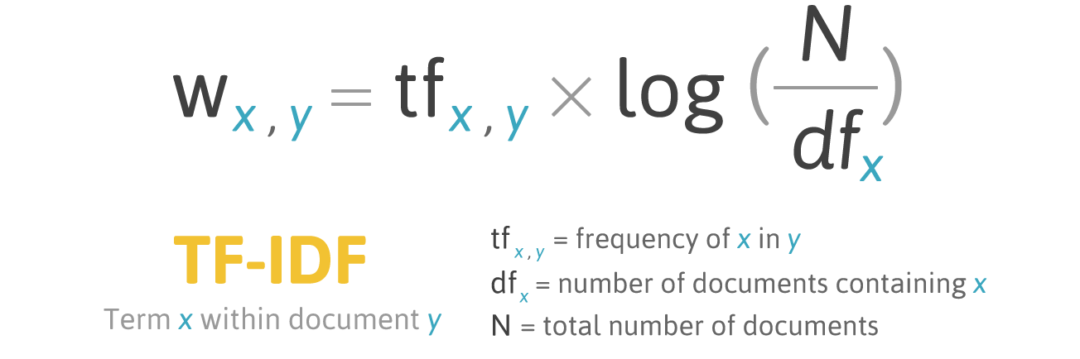

Slide 40
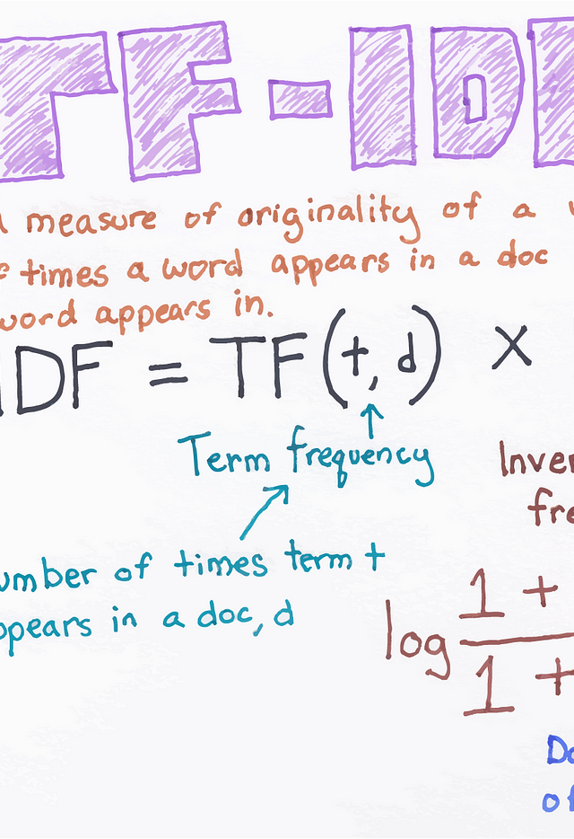
Term Frequency (TF) - Inverse Document Frequency (IDF)
Term Frequency (TF) measures how often a term appears in a document.
It is calculated by dividing the number of times a term appears in a document by the total number of terms in that document.
Inverse Document Frequency (IDF) measures how important a term is within a corpus.
It is calculated by dividing the total number of documents by the number of documents containing the term, and then taking the logarithm of the result.

Slide 41
Term Frequency (TF) - Inverse Document Frequency (IDF)
Simplified:
"If a word shows up a lot in one document (high TF) but isn't all over the place in other documents (high IDF),
then it's probably really important for that document.
In other words, it makes this document special"

Slide 42
Term Frequency (TF) - Inverse Document Frequency (IDF)
Simplified:
“The words with High TF-IDF scores are called Top Terms of that text.
By clustering texts with similar Top Terms, we can achieve what is called LDA Topic Modeling ”

Slide 43
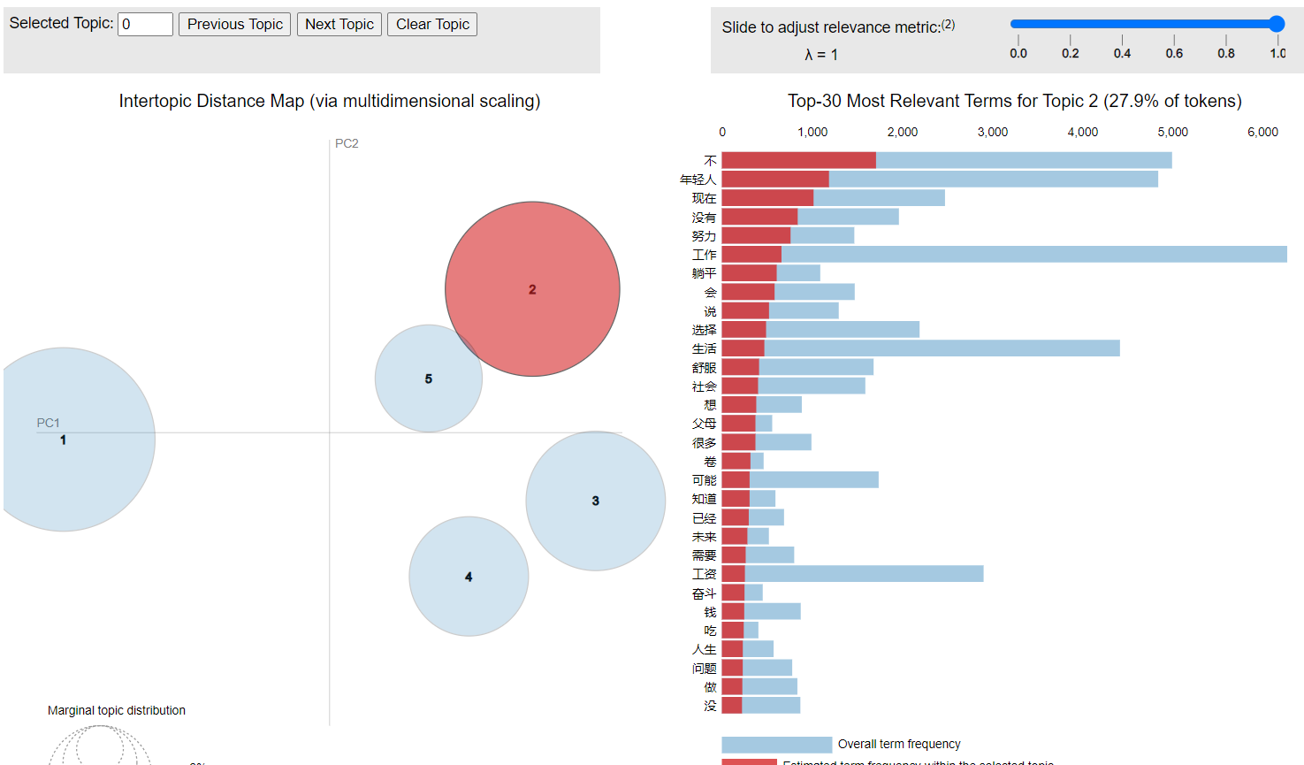

Slide 44
How is it helpful to our project?
LDA topic modeling allows us to cluster texts with similar topics together
Then, by examine the Top Term distribution of different clusters, we can have an idea of :
what are the aspects people focus on when posting the contents
And also, by clustering the texts, then analyze sentiment distribution, we may find what aspects shows positive sentiment distribution and what aspects shows negative ones.

Slide 45
3. What is Principle Component Analysis?

Slide 46


Slide 47
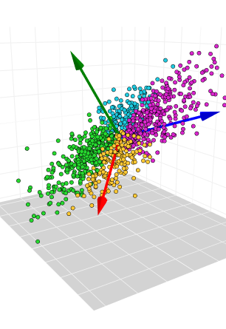
Principle Component Analysis
Principal Component Analysis (PCA) is a statistical technique used to simplify the complexity in high-dimensional data while retaining trends and patterns.
It does this by transforming the original variables into a new set of variables, called principal components, which are a linear combination of the original variables.

Slide 48


Slide 49

In a multiple dimensional space, where the sun casts the shadow to a two dimensional surface of each and every little dot that represents the final position of the text after following each direction the vectorized tokens points to.

Slide 50
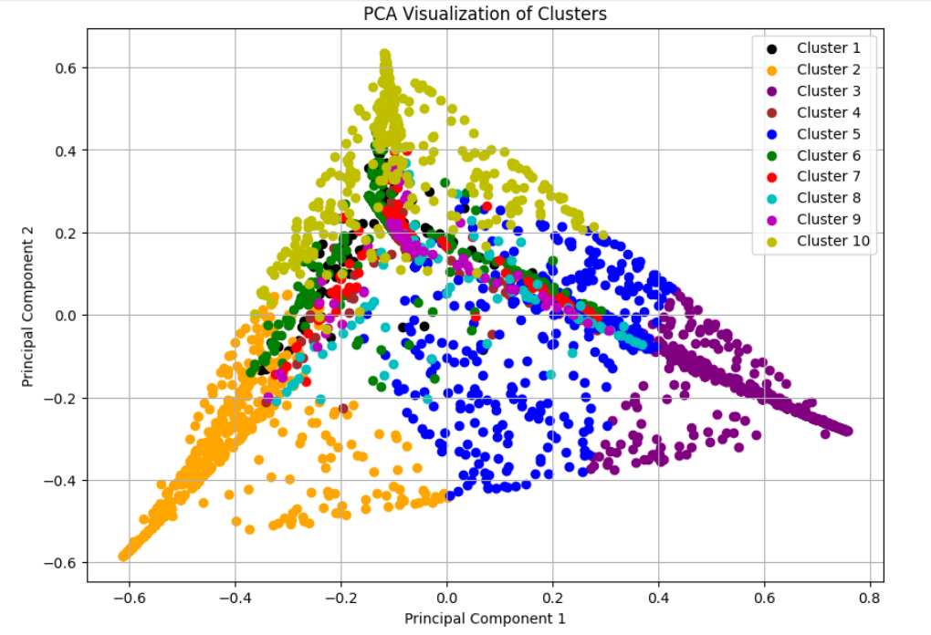
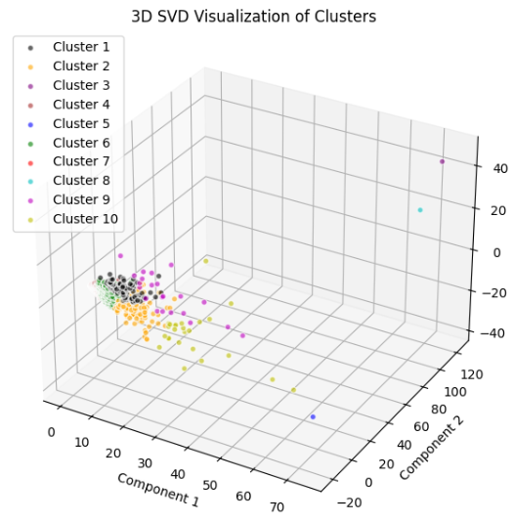

Slide 51
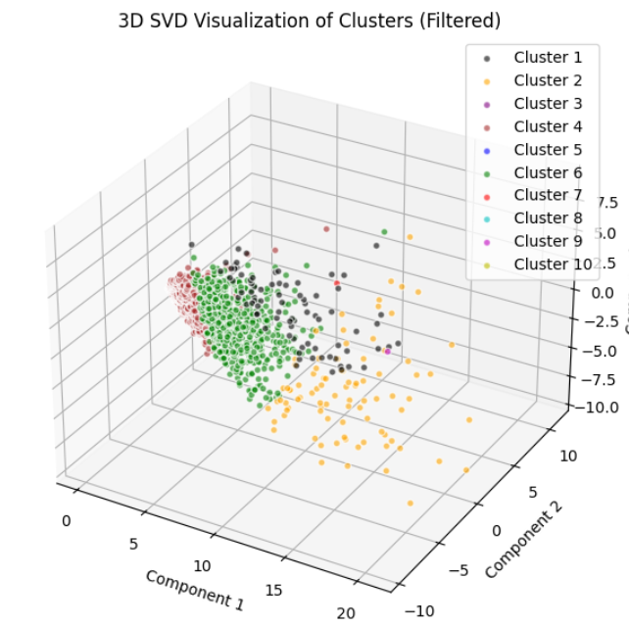
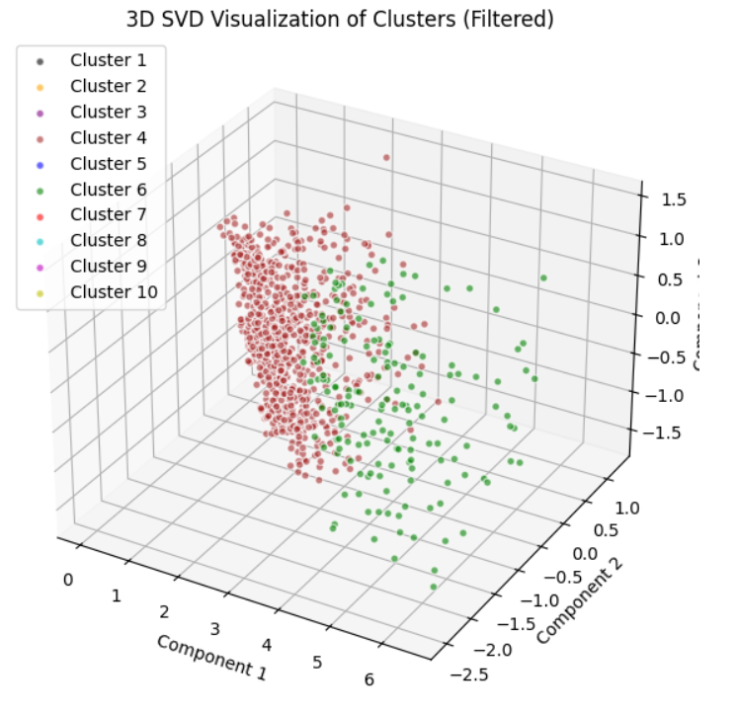

Slide 52
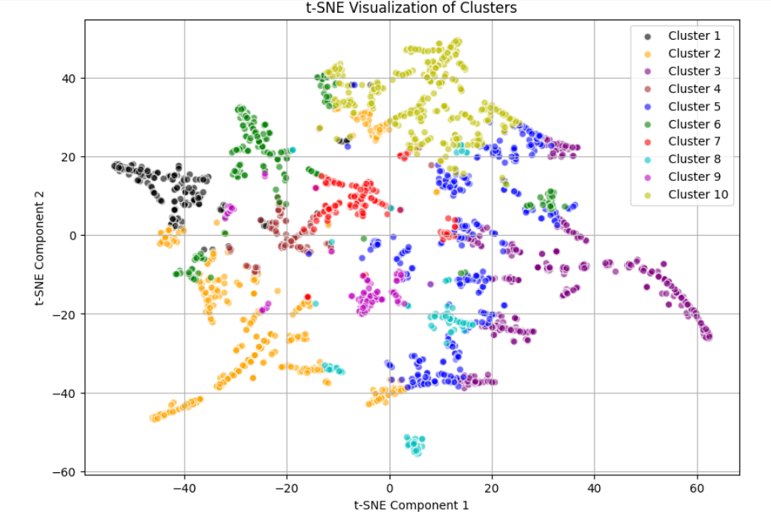

Slide 55
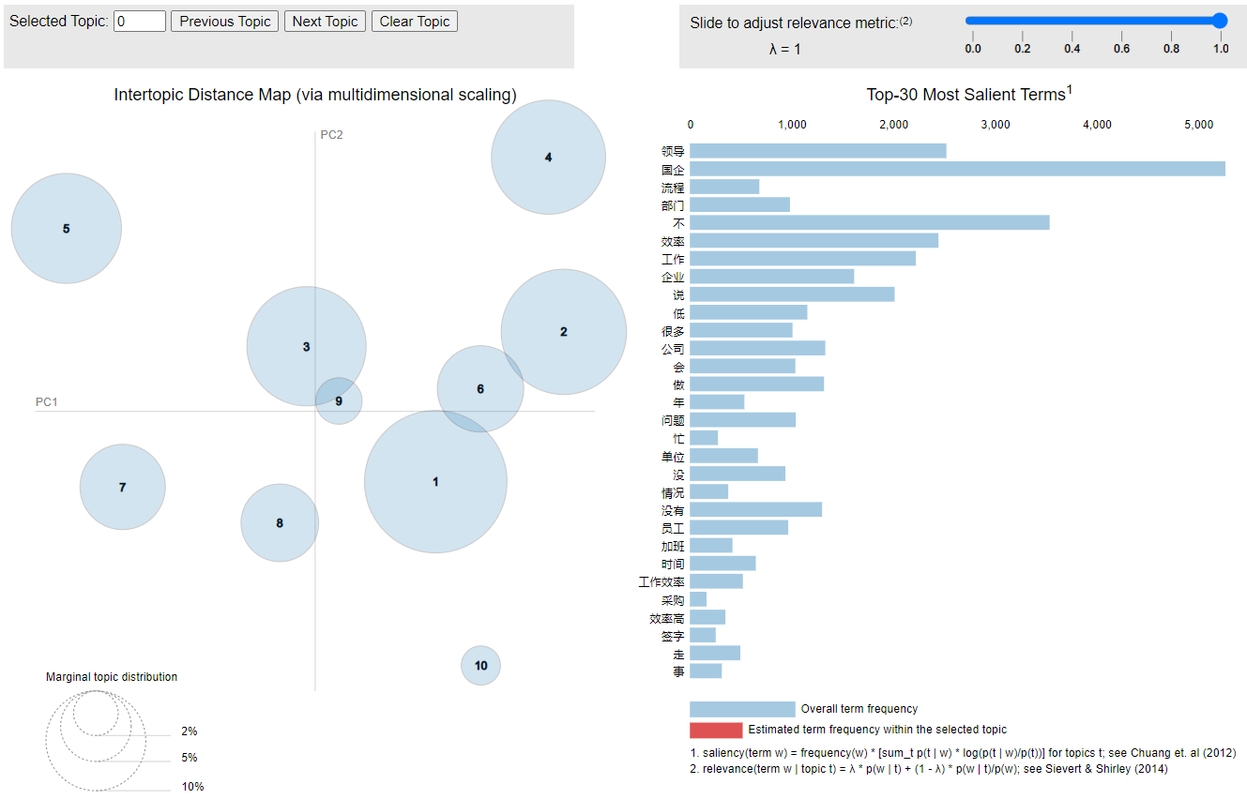

Slide 56
What does this mean?

Slide 57
What does this mean?
It means even if the texts are talking about the same topic (indicated by the Top Terms calculated based on TF-IDF scores),
their “representations” are different in the multi-dimensional vector space.
In other word: the same words may mean different things in different texts.

Slide 58

For Example: When Elon Musk and I are both talking about money, the concepts of “Money” would be totally different between us. Talking about the same topic doesn’t necessarily mean talking about the same thing.

Slide 59
How is it helpful to our project?
PCA serves as an alternative method to LDA topic modeling. The visual representation is more straight-forward
It can also double check the results to see if we have done it right.
It is always recommended to use more than one methods or theories to test your results.
But we are still managing to reduce the principle components to two dimensional.

Slide 60
What is Aspect-Based Analysis?

Slide 61
Aspect-Based Analysis:
Aspect-based analysis is a technique used to understand what people are specifically talking about in their reviews or comments and what they feel about those specific parts (aspects).
Think of it as a way to break down a review into smaller pieces and find out what people like or dislike about each piece.

Slide 62
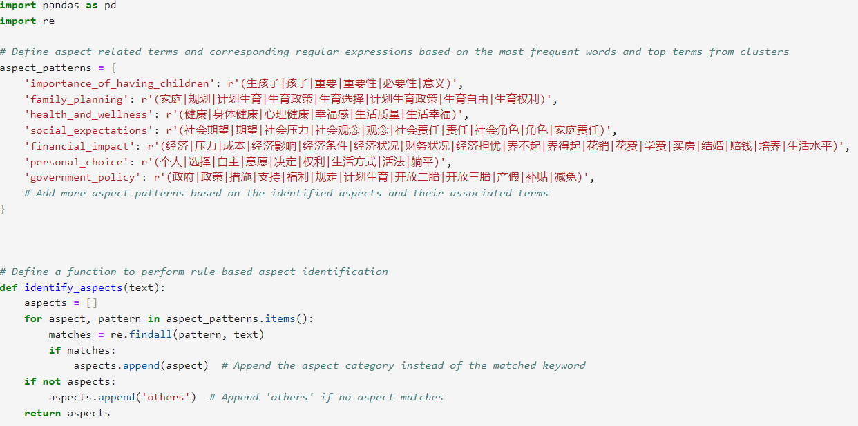

Slide 63
Imagine This:
You have a review about a restaurant:
"The food was amazing, but the service was slow and the ambiance was just okay."

Slide 64
Imagine This:
You have a review about a restaurant:
"The food was amazing, but the service was slow and the ambiance was just okay.“
In this review, the person is talking about three different aspects:
Food
Service
Ambiance

Slide 65
How Aspect-Based Sentiment Analysis Works:
Identify Aspects: First, it finds the different aspects or parts of the review.
In our example, the aspects are:
food,
service,
ambiance.
Analyze Sentiment for Each Aspect: Then, it figures out what the person feels about each aspect.
Is it positive, negative, or neutral?

Slide 66
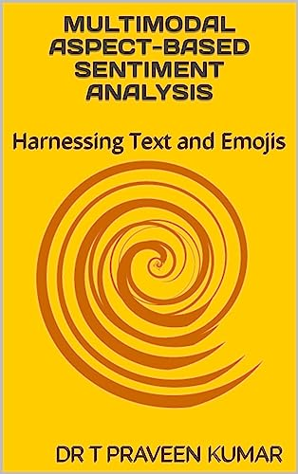
Breaking Down the Example:
Food: "The food was amazing"
Aspect: Food
Sentiment: Positive
Service: "the service was slow"
Aspect: Service
Sentiment: Negative
Ambiance: "the ambiance was just okay"
Aspect: Ambiance
Sentiment: Neutral

Slide 67
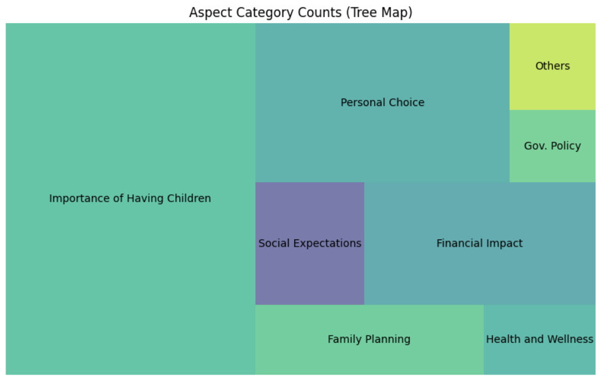
Figure 1.1 Public Aspect Tree Map on Having babies

Slide 68
Examples: “Do you think it is important to have children?”

Slide 69
Example: Public Spectrum Summary
Frequent Words and Topics
Cluster Distribution
Not Important
Social Values
Financial Impact
Parenting
Overall Sentiments: Negative
The PCA visualization shows that the clusters are not clearly separated, suggesting that the discussions on having children are multifaceted and consist of a variety of perspectives.
Aspect Frequencies
Sentiment Distribution
The aspect frequencies indicate:
Importance of Having Children
Personal Choice
Financial Impact
Social Benefits
The sentiment distribution for each aspect reveals that the overall sentiment is mostly negative across all aspects. However, there are some variations, with "Government Policy" having a slightly lower negative sentiment.

Slide 70
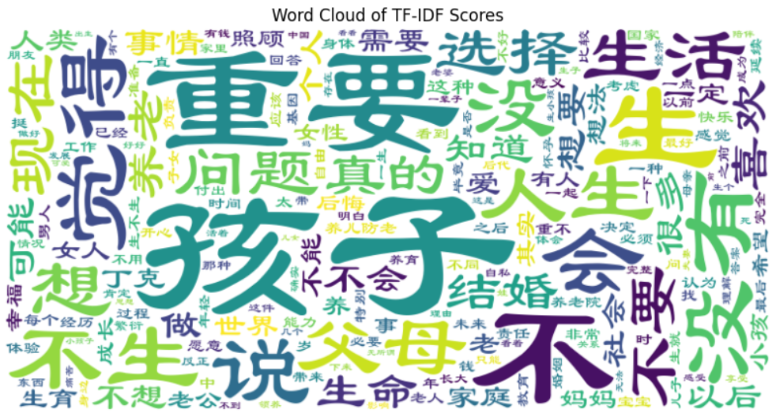

Slide 71
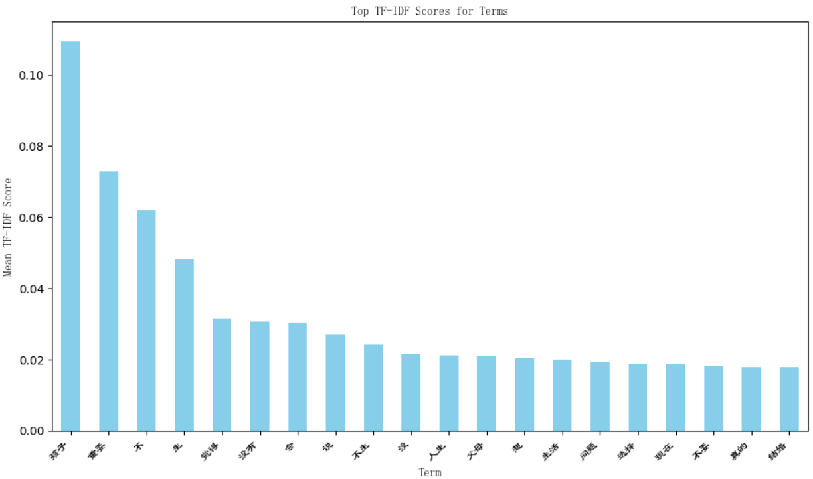

Slide 72
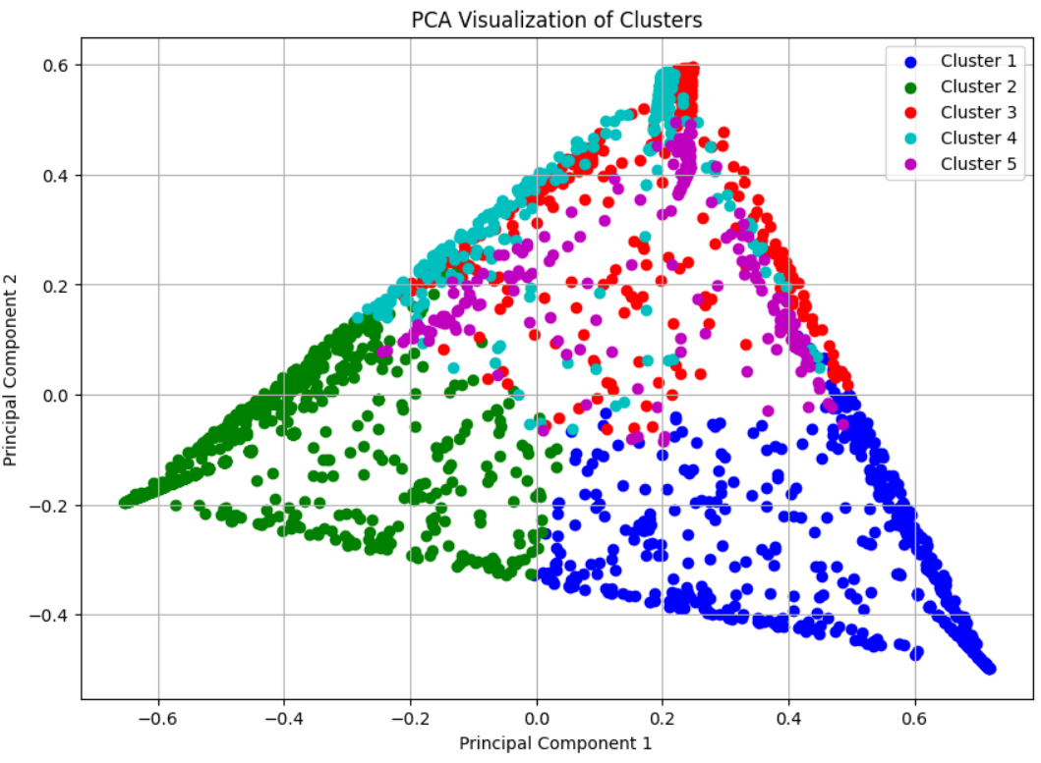

Slide 73
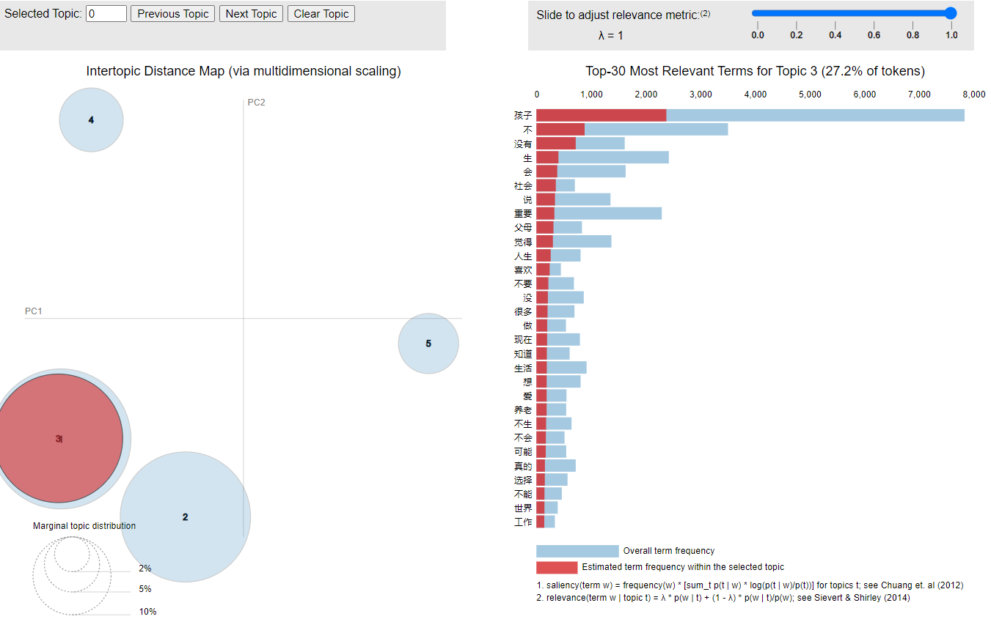

Slide 74
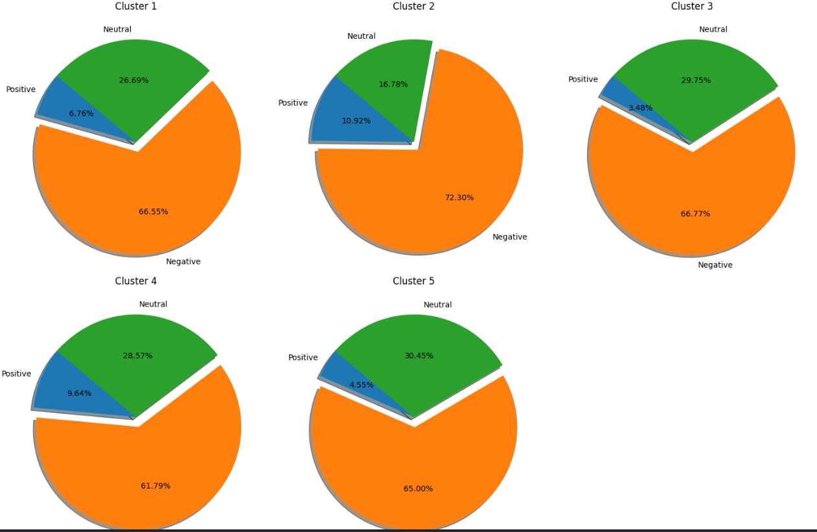
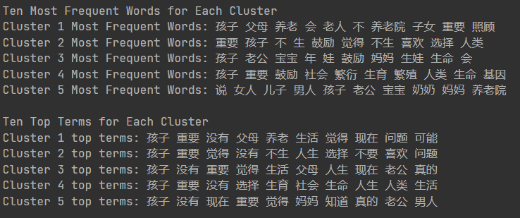

Slide 75
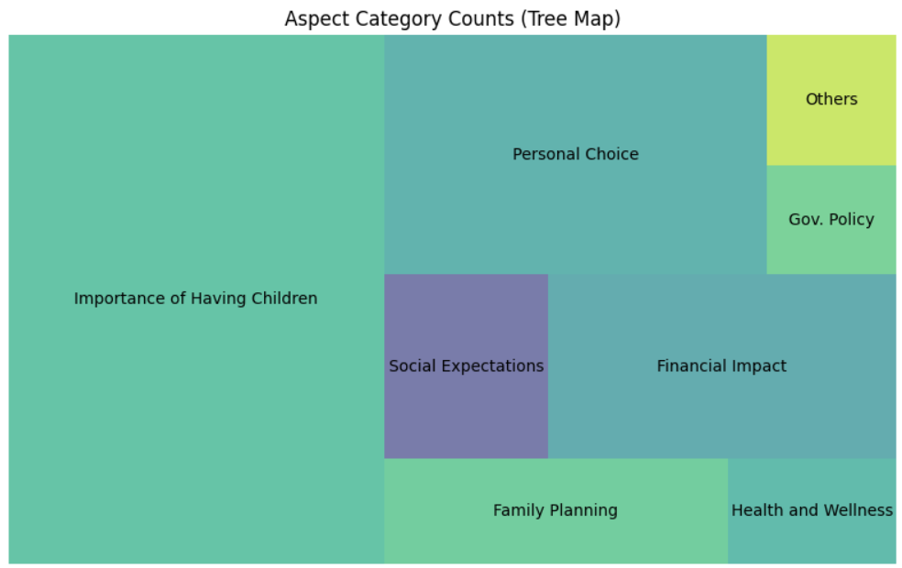

Slide 76
Example: Public Spectrum Summary
Frequent Words and Topics
Cluster Distribution
Not Important
Social Values
Financial Impact
Parenting
Overall Sentiments: Negative
The PCA visualization shows that the clusters are not clearly separated, suggesting that the discussions on having children are multifaceted and consist of a variety of perspectives.
Aspect Frequencies
Sentiment Distribution
The aspect frequencies indicate:
Importance of Having Children
Personal Choice
Financial Impact
Social Benefits
The sentiment distribution for each aspect reveals that the overall sentiment is mostly negative across all aspects. However, there are some variations, with "Government Policy" having a slightly lower negative sentiment.

Slide 77
Example: Government Spectrum Summary
Top 8 Most Frequent Words
Top 8 Top Terms
Birth Rage
Population,
Economic Development
Policy,
Nation
Government Work,
Planned Birth
Service
Population
Birth Rate
High Quality (development of society)
Policy
Planned Birth
Service
Economic Development
Specialty of China
(which, in most of the contexts, means the institutional advantages of Socialism with Chinese Characteristics)

Slide 78
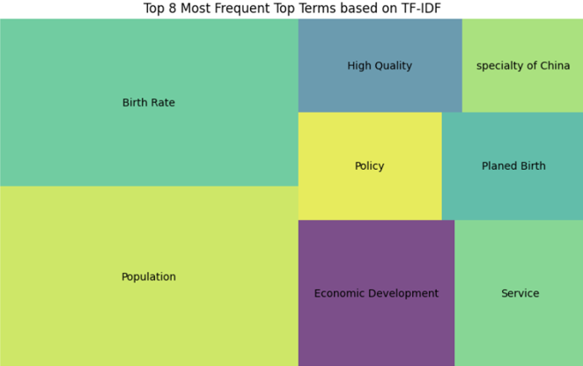

Slide 80
These results align with our initial guess, that the Chinese government's primary concern may be macroeconomic factors such as:
population growth
birth rate stability
economic development
social stability
rather than eliminating poverty, social injustice and improvement of social welfare.
These objectives may prioritize demographic trends and workforce dynamics rather than individual concerns about social welfare and financial impacts.
The governments may also have political motivations to emphasize certain aspects of policies to maintain stability and support.
This could include highlighting themes related to national pride, economic prosperity, and social cohesion while downplaying potentially contentious issues or criticisms.

Slide 81
What is your theory for this phenomenon?

Slide 82

The legitimacy of the Chinese Communist Party’s rule comes from economic development, social stability, and social fairness.
Therefore, the government have political motivations to emphasize certain aspects of policies to maintain stability and support.
Any content that exposes its low governance capabilities in terms of people's livelihood, social welfare, social equality and legal system will weaken the legitimacy of its rule.

Slide 83
03
What’s Next?

Slide 84
What we’ll start doing this summer
Train Our Own Model
More Statistics Approach
For Opinion Extraction, we would have to manually label all the data and then use it to train our own classifier.
This way, we would be able to extract the opinion toward certain questions, like:
“strongly agree”
“agree”
“neutral”
“disagree”
“strongly disagree”
This would give us more control over the parameters to fine tune the sensitivities of the model toward the text.
To date, we have not conducted any regression analyses for correlations or pursued causal analysis.
We plan to explore additional methods when time permits, such a:
Confirmatory Factor Analysis
Exploratory Factor Analysis
We may also use Cosine Similarity and KL Divergence to analyze the changes in government internal references to see if there are changes in style, tones and focus throughout the time frames

Slide 85

And of course, manually check the data to see if there are anything interesting

Slide 86
Thanks!
Do you have any questions?
Fengdi.Huang@edu.rtu.lv
Zhen.Pan@edu.rtu.lv
Our GitHub: https://github.com/JesseLovesGrace/CN_Spectrum

Slide 87
And A Lot Of Coding!!! Thanks to ChatGPT 3.5, we managed to finish this project just in time

Slide 88
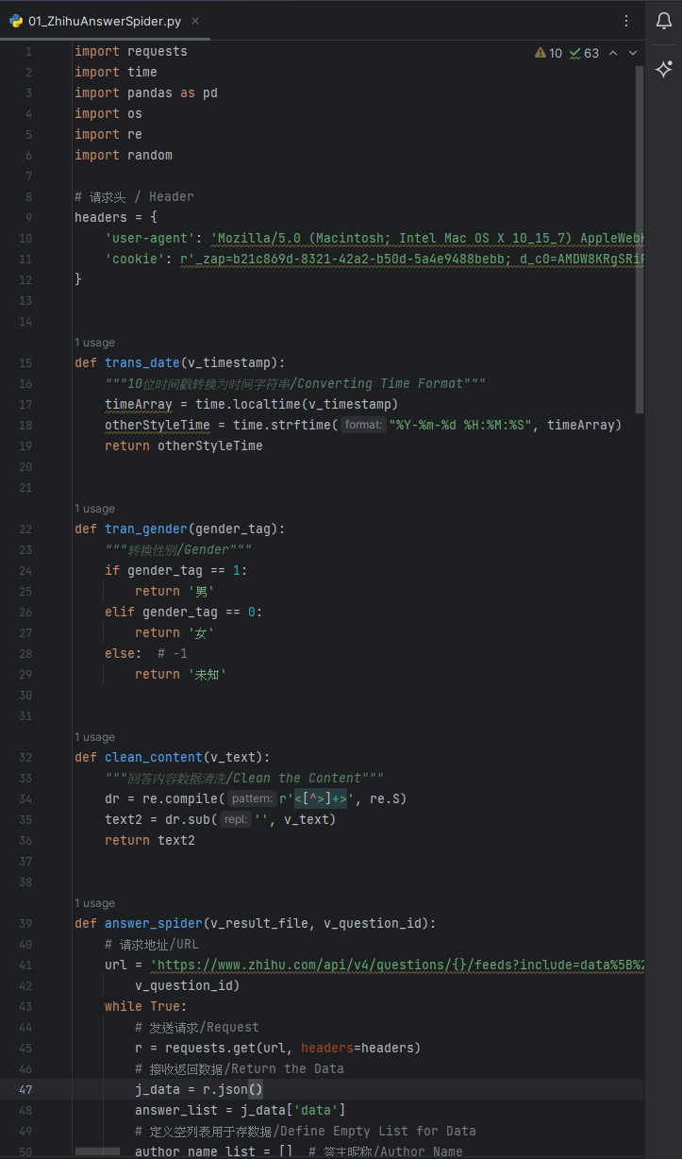
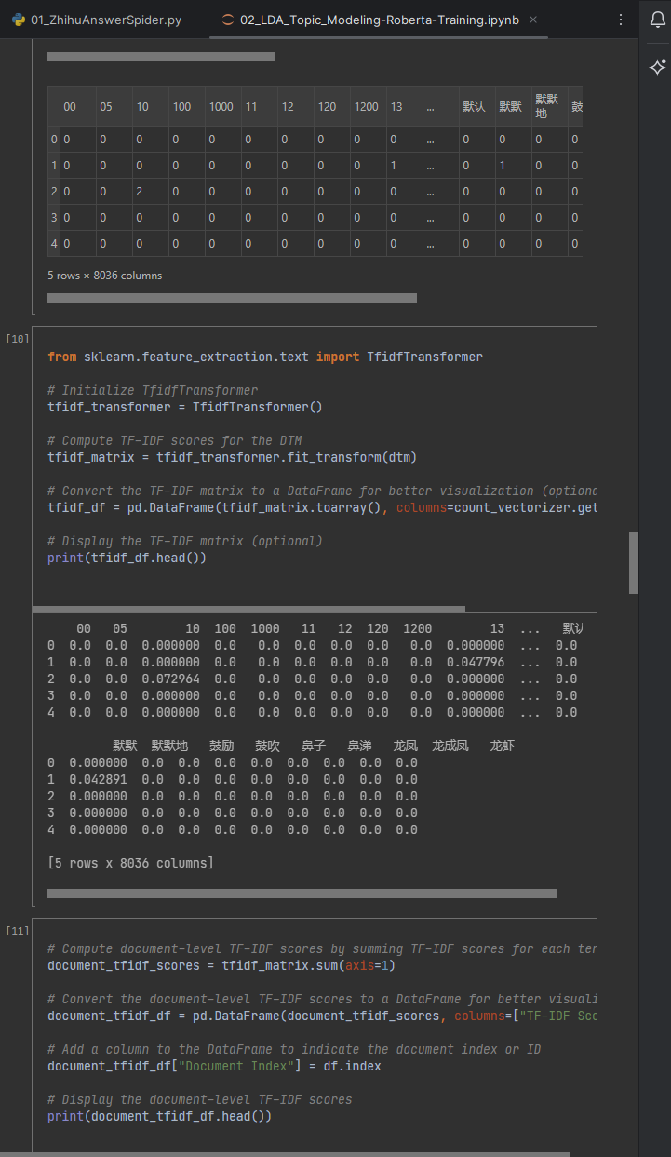
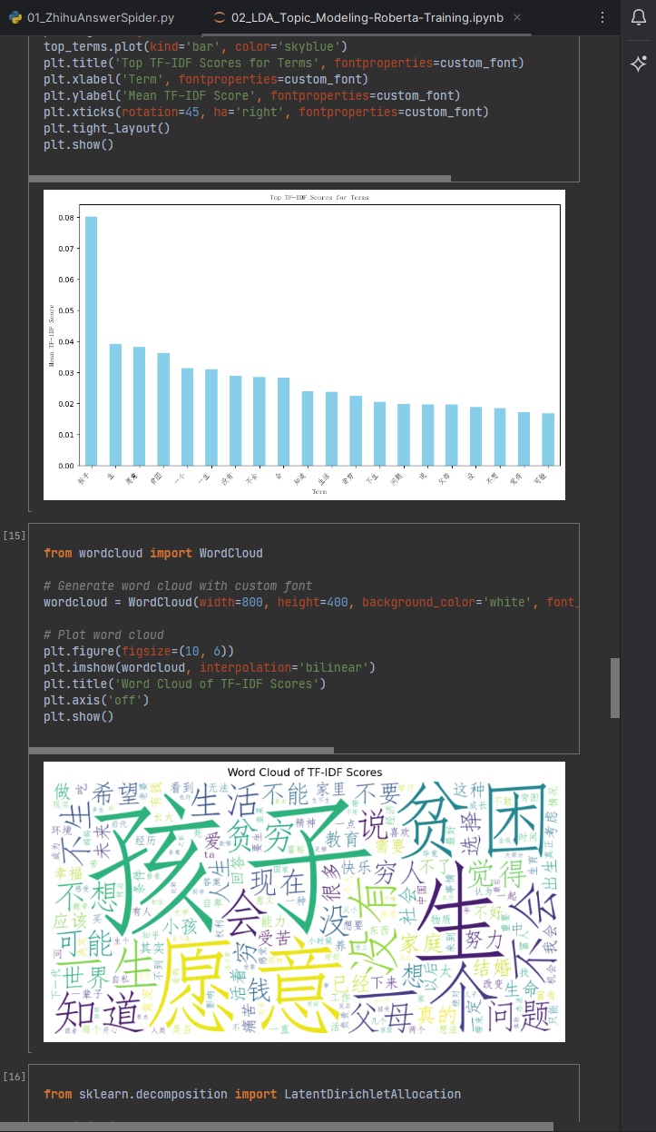
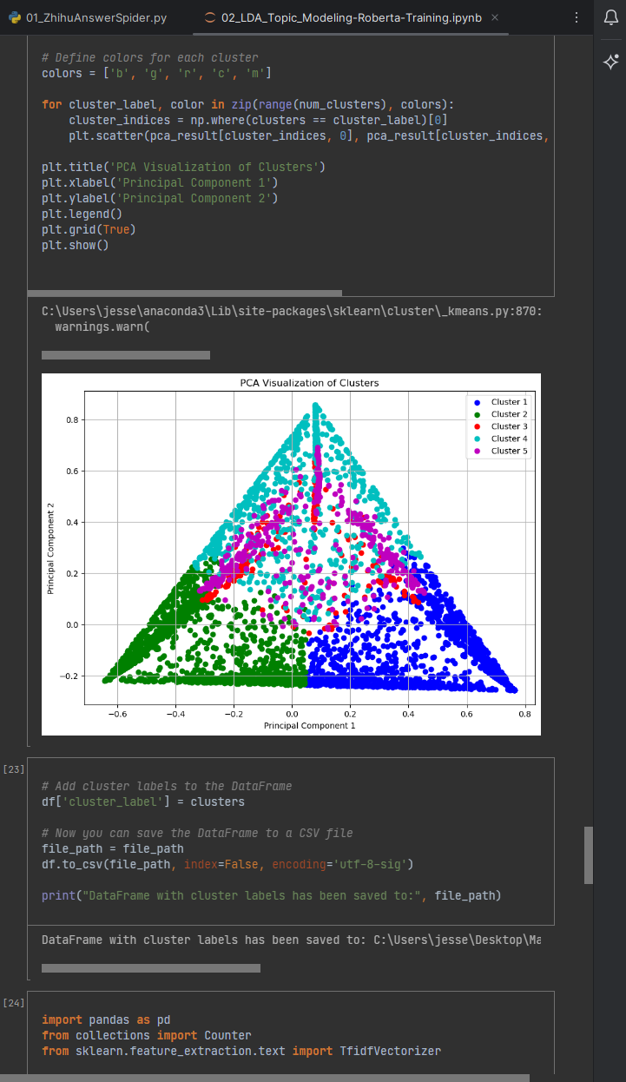
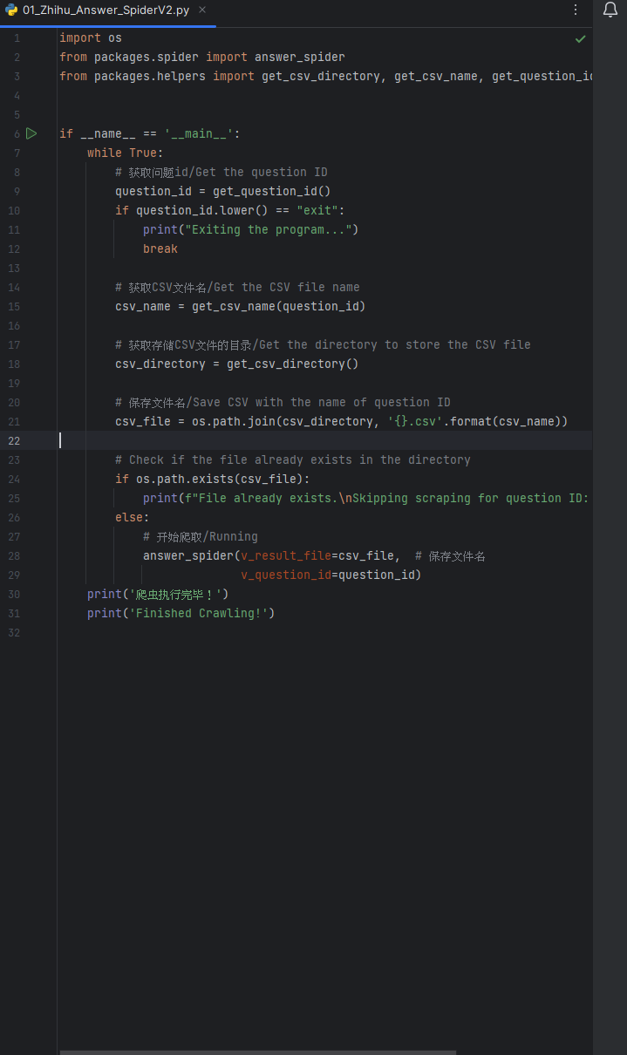
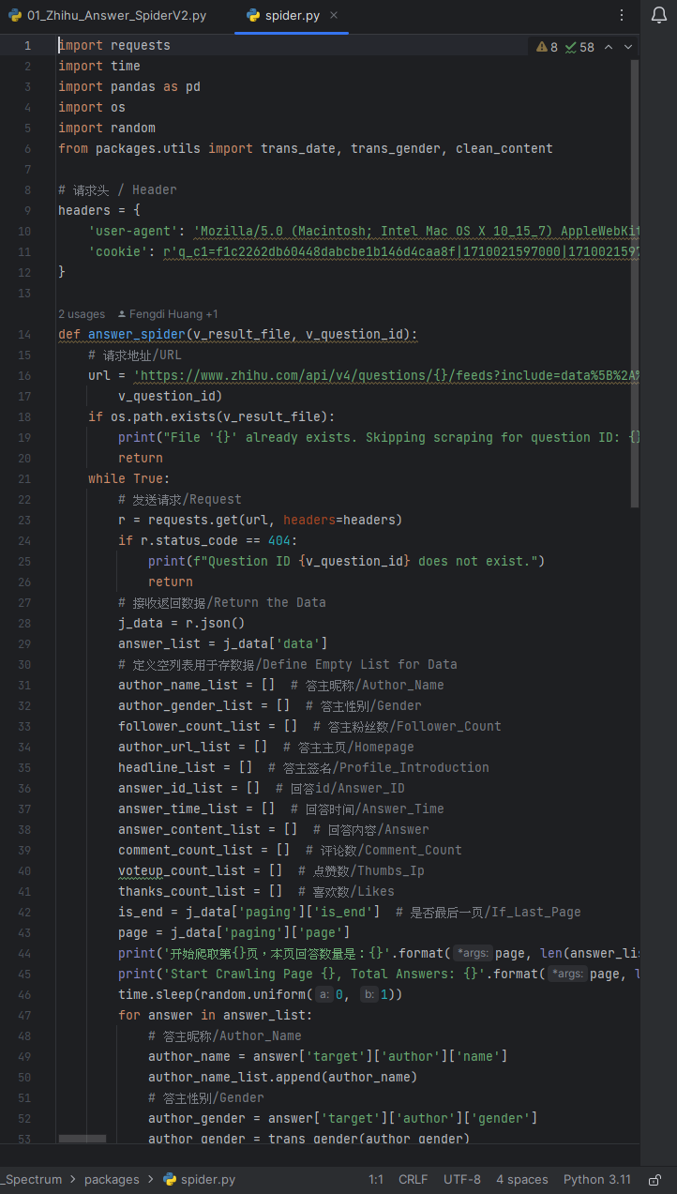
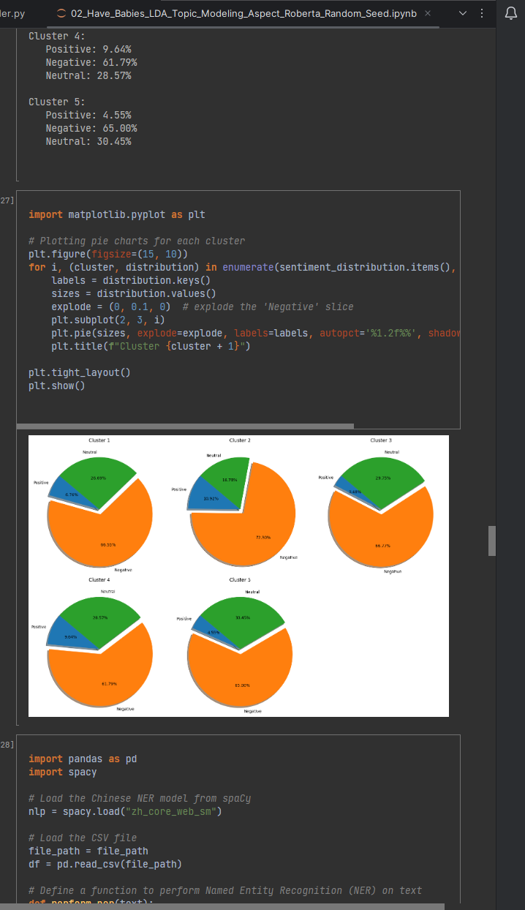
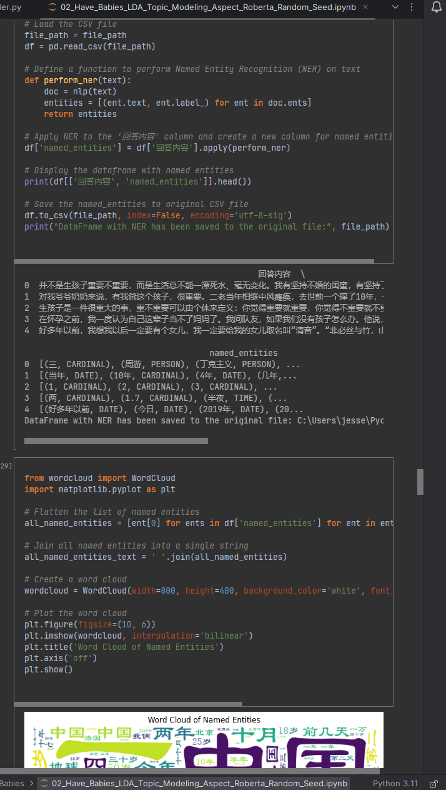
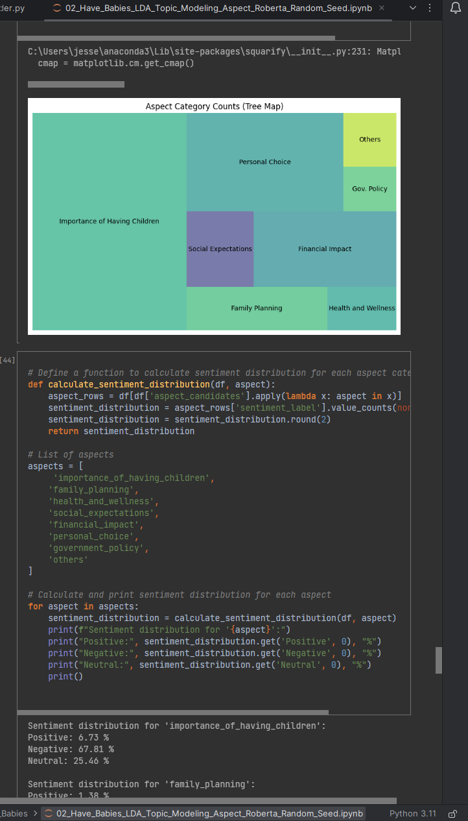
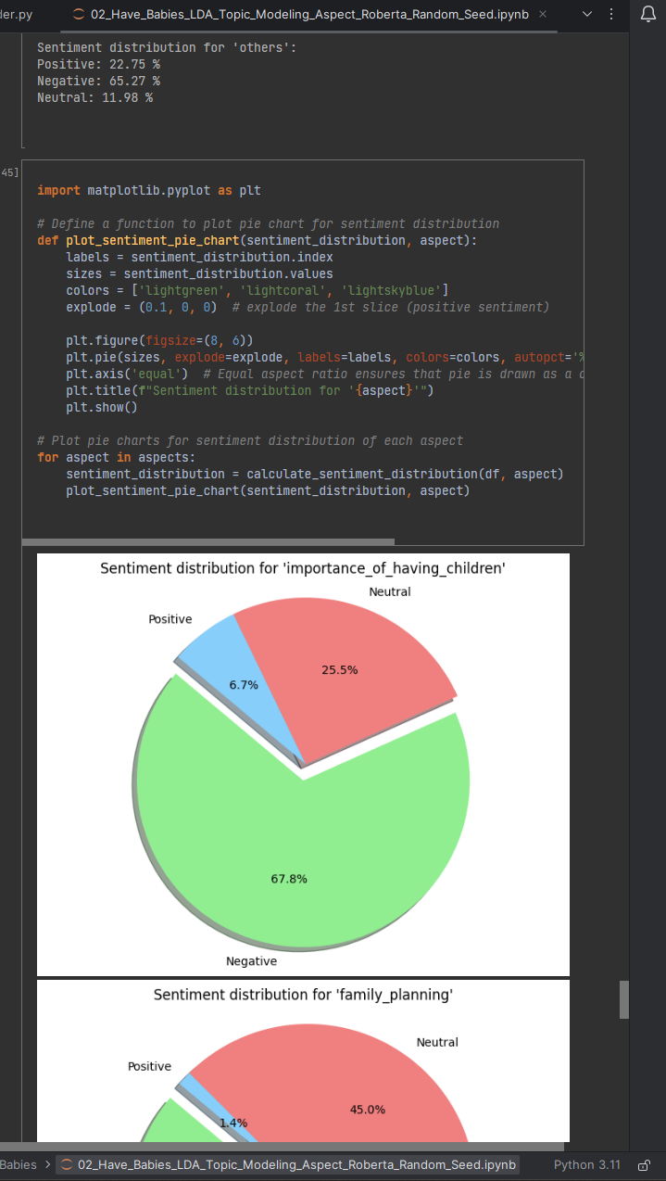
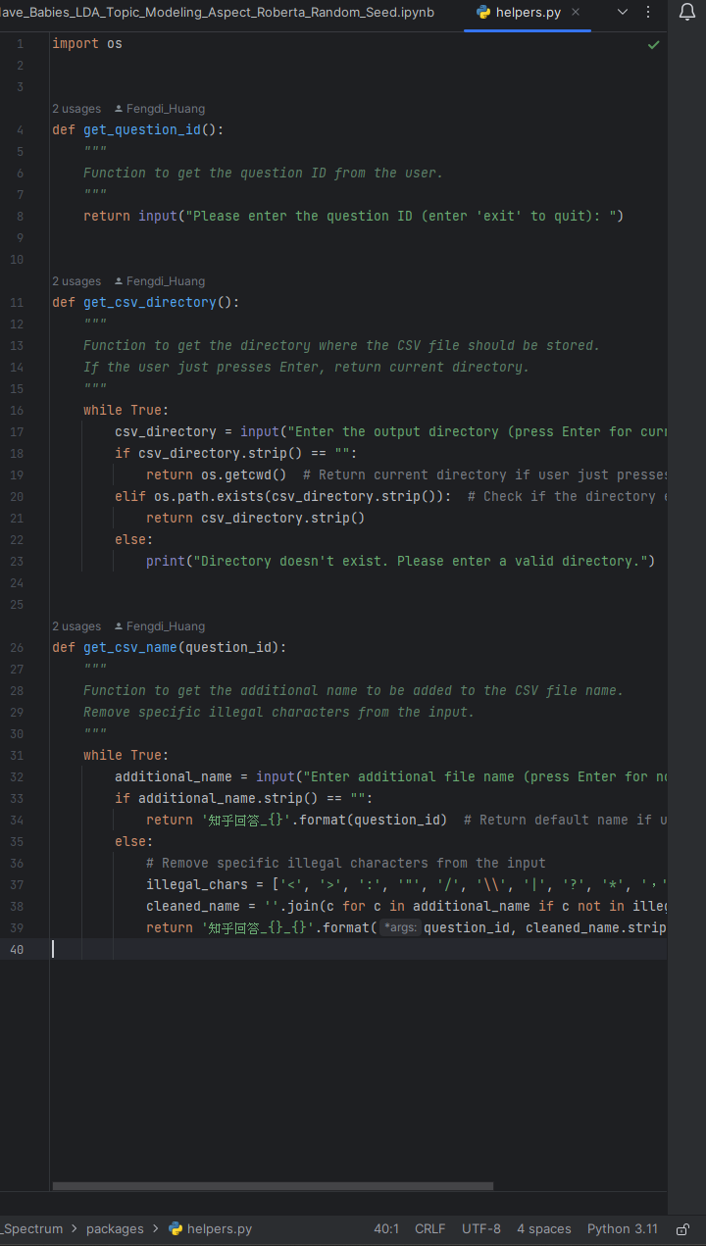
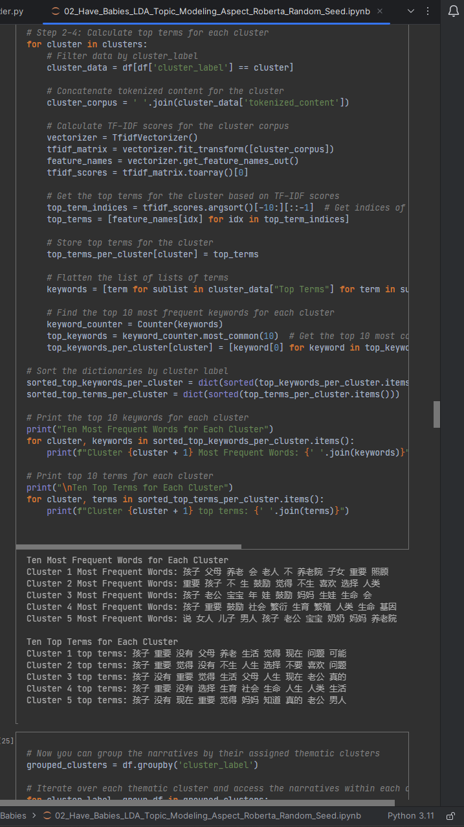

Slide 89
